Slide 1
Group 32
Matthew, Junwei, winston
We are going to fail!!! yey

Slide 2
Video Story Type: fiction, short film
Log Line: MC is a loner, does not have real friends, so he creates a plan to help him get famous, first by faking weakness to others, then showing superiority and beating up a bully. Thus, he gets followers and becomes famous within the school.
The concept of the film (what if?): What if the victim fights back against the bullies?
The vicarious experience(s) in your story(what would it be like…?): What would it be like to bully a martial artist?
Main Theme: Bullying, it occurs to anyone of any age, race, religion, and in this case, profession.
Conflict breakdown of the protagonist(want/buts of the protagonist): Martial arts is a form of protection, not to be used in revenge or to hurt others weaker than him. MC takes revenge on the bullies, which goes against what he has learnt.

Slide 3
Concept Ideation

Slide 4
Structural points of your film, indicating the specific events
Start of the film: cinema beeping countdown+MC waking up, then in school,”I'm so excited for my first day of class, who knows how many new friends i will meet today.”
Inciting Incident: It occurs when the bullies purposely bumps the victim on the shoulder forcefully and bullies acts aggressively. (Shows that MC does not actively incite anger and violence)
1ST PP: Victim(Jun Wei) acts weak and backs away while apologizing profusely but the lead bully(Matt) shoves victim to the wall MC is backed against the wall. Bullies stand opposite him, blocking his path of escape. Lead bully(Matthew) attacks MC, the other bully(Winston) stands back and watches, laughing. SDA(Basil) appears to stop them because of social distancing, but bullies back away aggressively and start using slurs on MC. ie, suggestive language. (shows that the incident is not yet over, which causes fear of being bullied)
Midpoint: Victim talks to his online friend about recent bullying(discord). Victim asks friend for advice on what he should do regarding the situation. Friend’s identity is still uncertain now. (Shows conflict between the situations)
2ND PP: Mc reaches breaking point after a few days of continuous bullying, A random stranger(Basil) saw the entire fight and decided to record it and post it on social media.
Climax/Plot twist: he breaks and fights back, beating up the bullies(he knows how to fight/martial arts). Bullies run away in fear. (Shows that MC will do what it takes to protect himself)

Slide 5
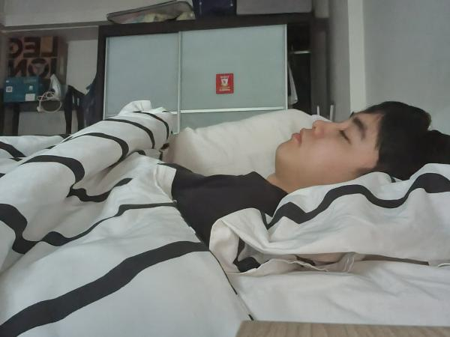
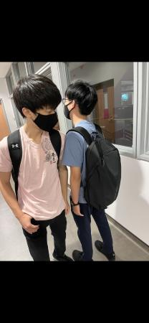
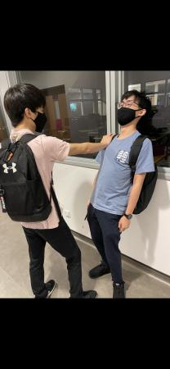
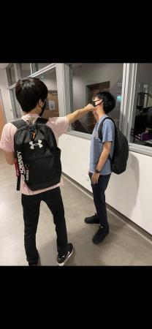
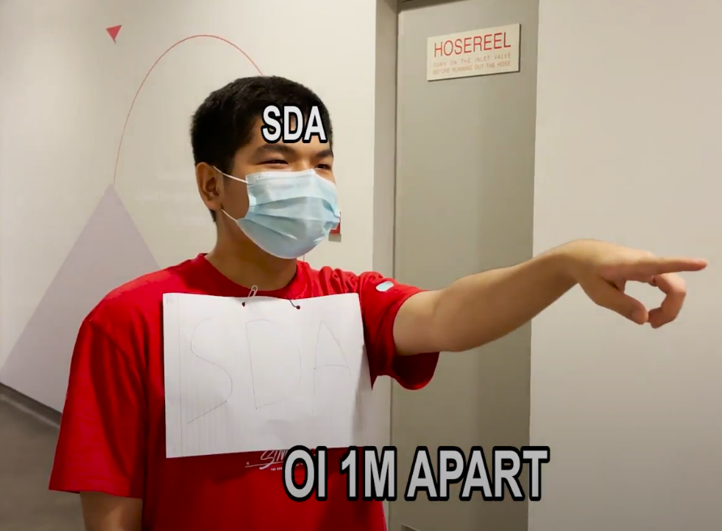
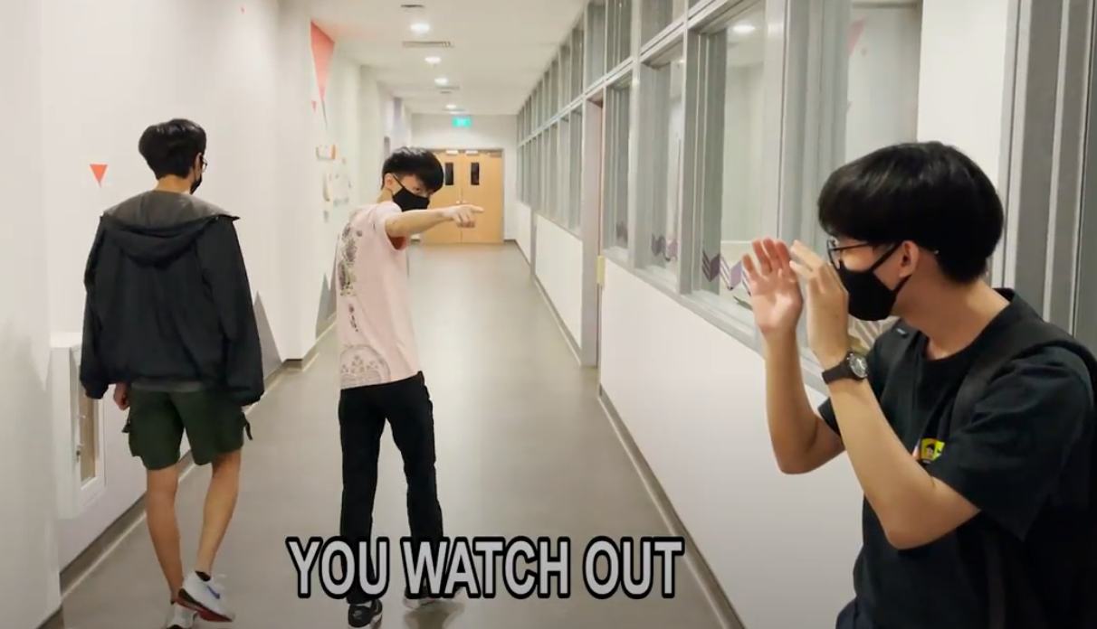
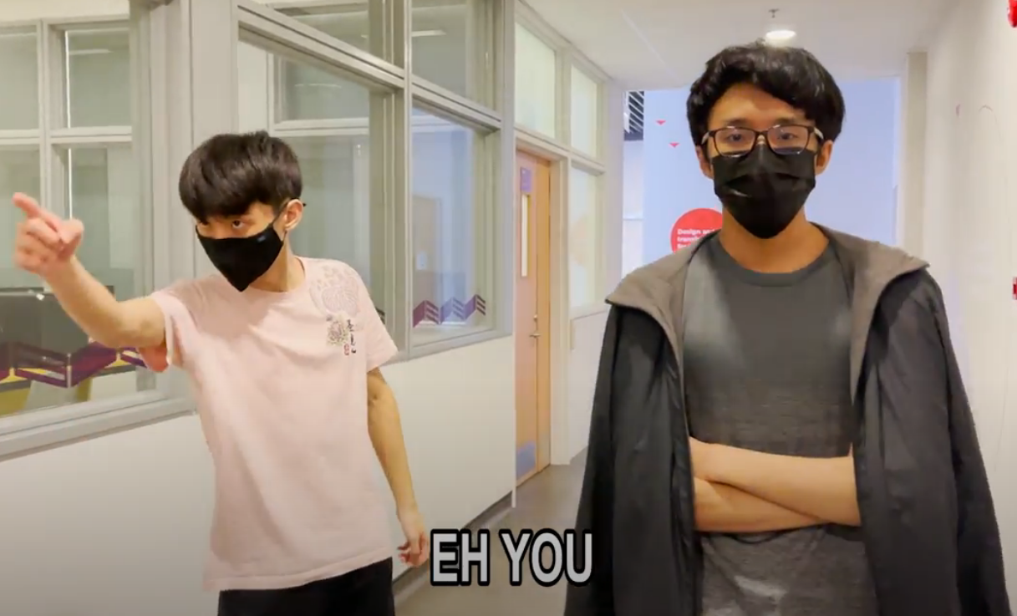
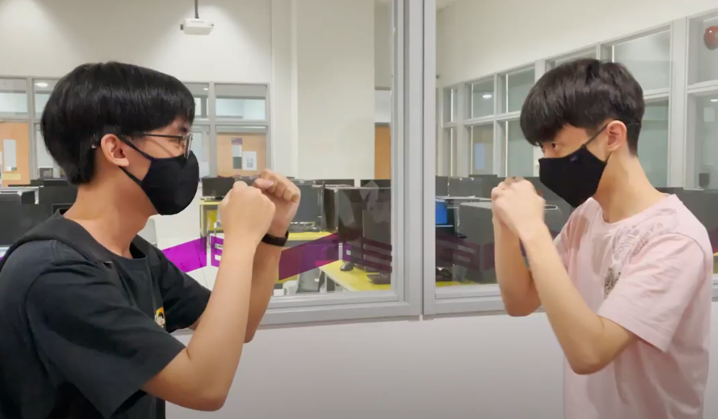
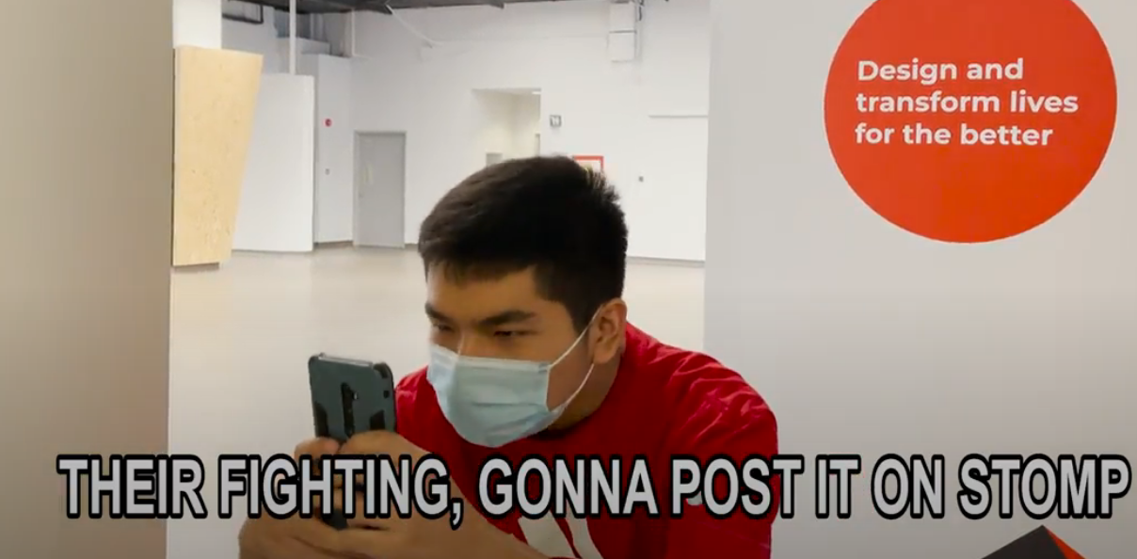
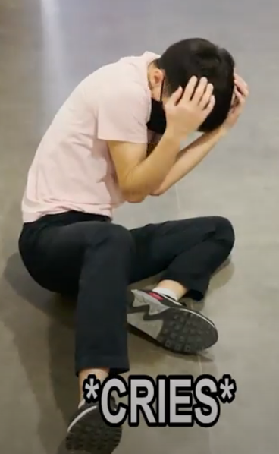
StoryBoard
2. MC goes to school
7. Both parties walk away
8. MC and bullies meet again
9. fight scene again
10. person takes a video
11. Bully loses
12. MC gets famous

Slide 7
Individual contributions
10-15 mins, slides include group report, storyboard, individual contributions, concept ideation

Slide 8
Thank you
ok goodbye :)

